Slide 1

Project Collaborators
Ethol Palmer
Ashweej Shenoy
John Mangahas
Monique Rowe

Slide 2
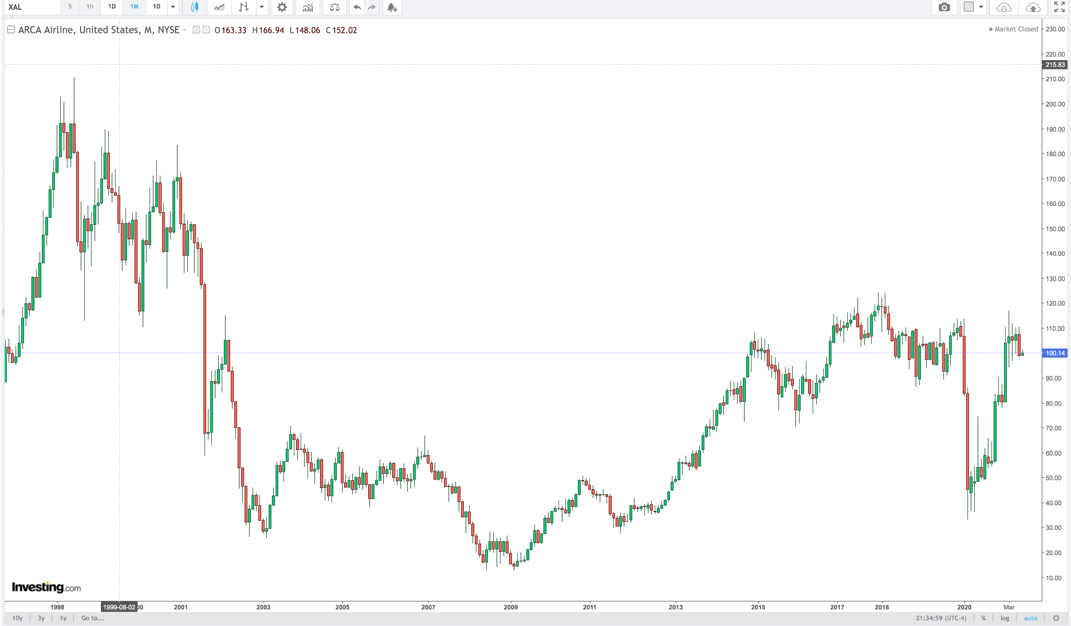
Hypothesis
Do the Business fundamentals justify the US Airline Industry Stock Prices (proxy: NYSE Arca Airline Index) during the Covid-19 pandemic?
2019

Slide 3
Data Sources
Data Exploration & Clean up Process
Stock Price Data from Alpaca API
Balance Sheet and Income Statement Data are sourced from SIMFIN API and StockAnalysis website
Passenger Number Data, Flight Numbers Data, Revenue Passenger-Miles Data, Available Seat-Miles Data, and Load Factor data sourced from Bureau of Transporation Statistics
Evaluation of data types
Checking, Removal of Nulls, and Duplicates
Concatenating the data from different Sources
Datetime format
Limitation on Data pulls

Slide 4
Analysis Process
Passenger
Flight Data
Revenue Passenger-Miles
Available Seat-Miles
Load Factor
Stock Price
Industry Employment Data
Employment Mix
Revenue
Net Income
Gross Profit Margin
Net Profit Margin
Operating Margin
EPS
Cash & Cash Equivalents
ROE
Price to Earning Ratio (P/E)
Price to Sales (P/S)

Slide 5
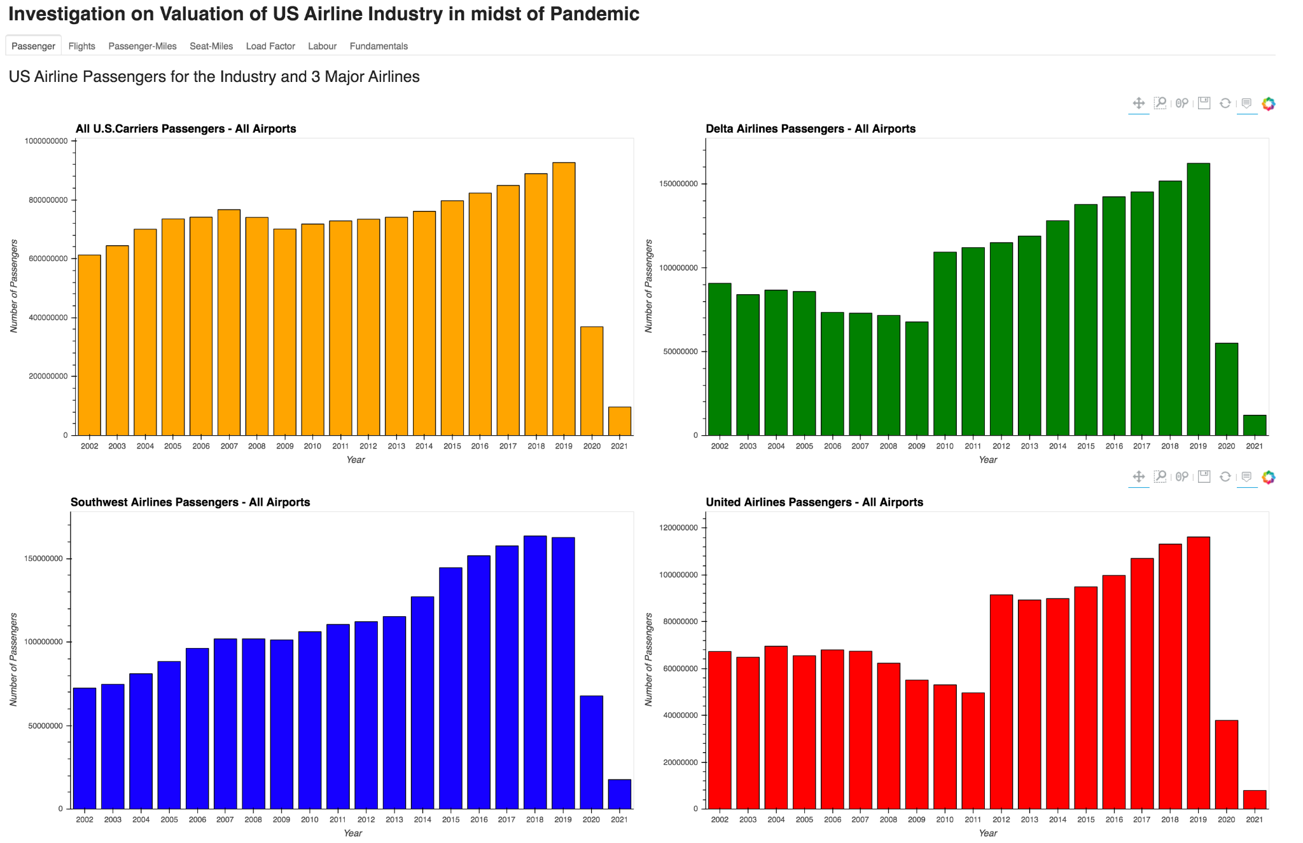
Conclusion & Dashboard

Slide 6
Thank you!

